Slide 1
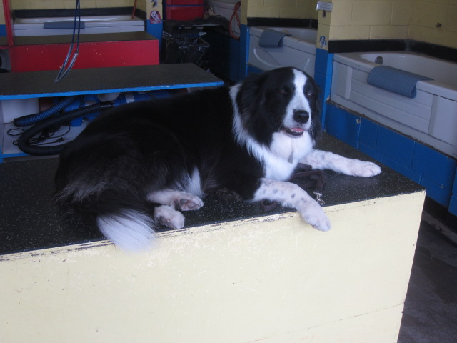
Hi! I’m Brody.
I am a border collie and I love hanging out at Launder-A-Pet.
I meet, greet and entertain customers, and play with my friends.
My hobbies include agility, sheep herding, teaching obedience classes and going for on and off leash walks. Also, did I mention my ball? I love my ball!

Slide 2
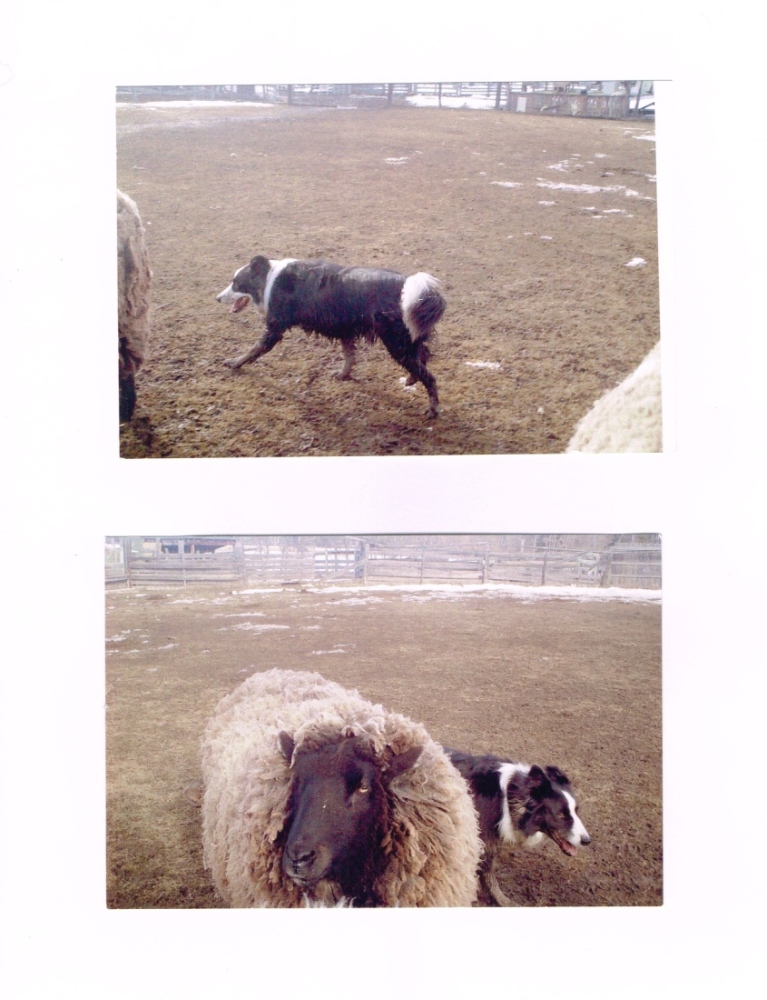
Are you out working?

Slide 3
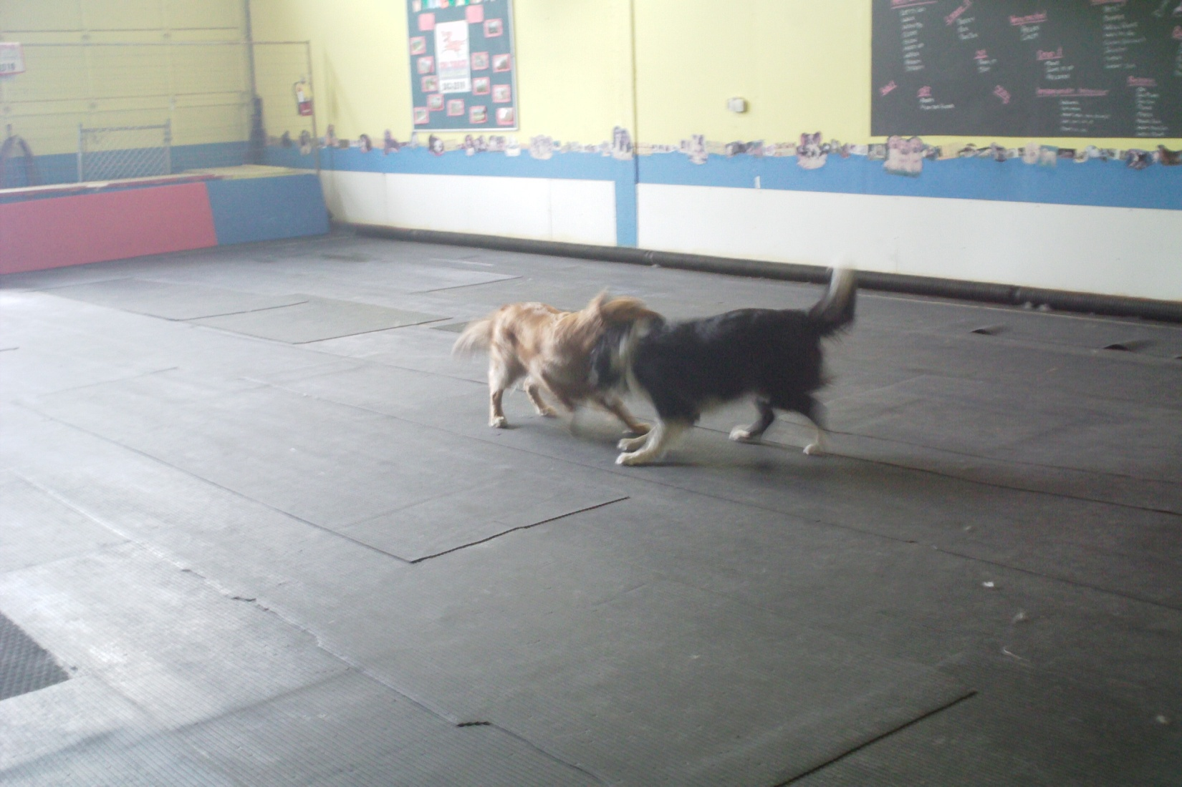
Playing?

Slide 4
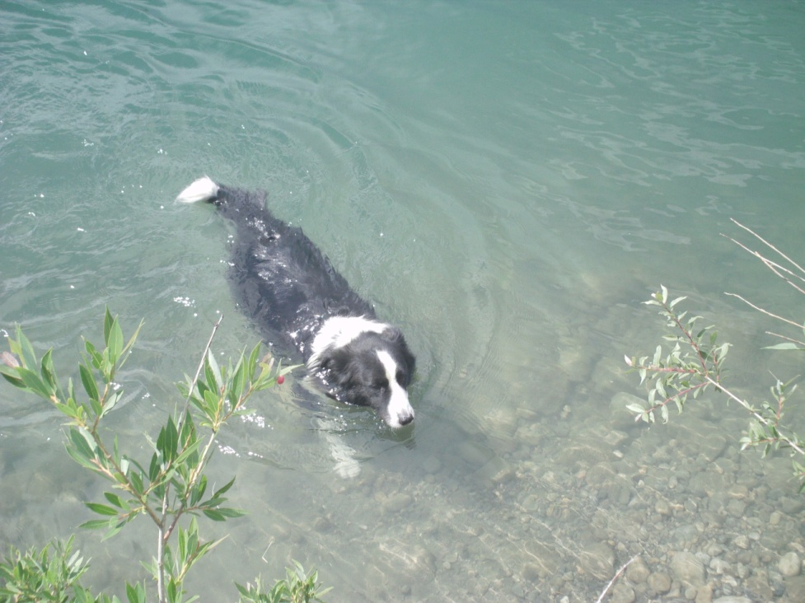
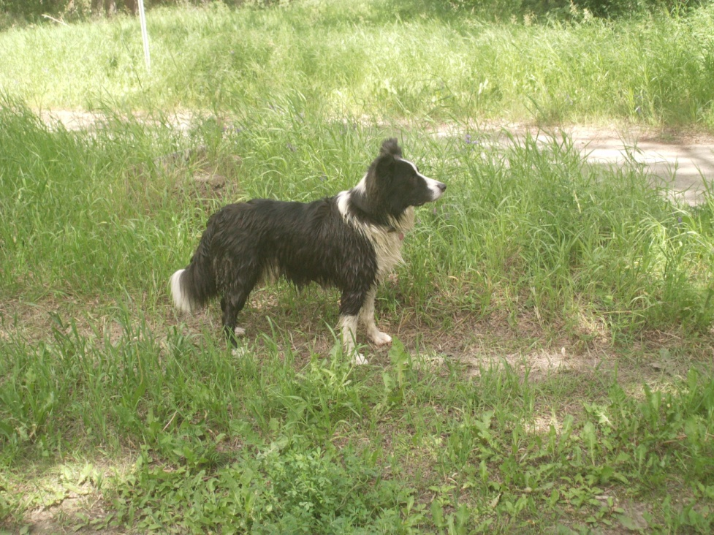
Or Looking for Adventure?

Slide 5
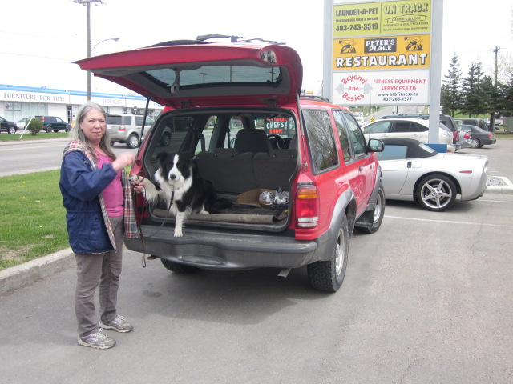
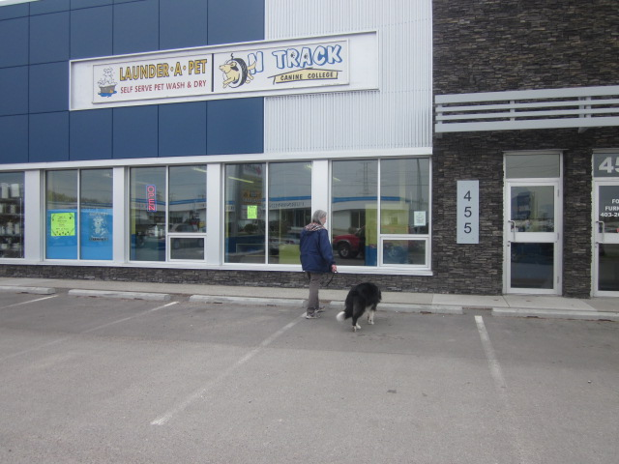
Do you get dirty like me? Follow me to Launder-A-Pet Self-Serve Dog Wash.
No appointment necessary.

Slide 6
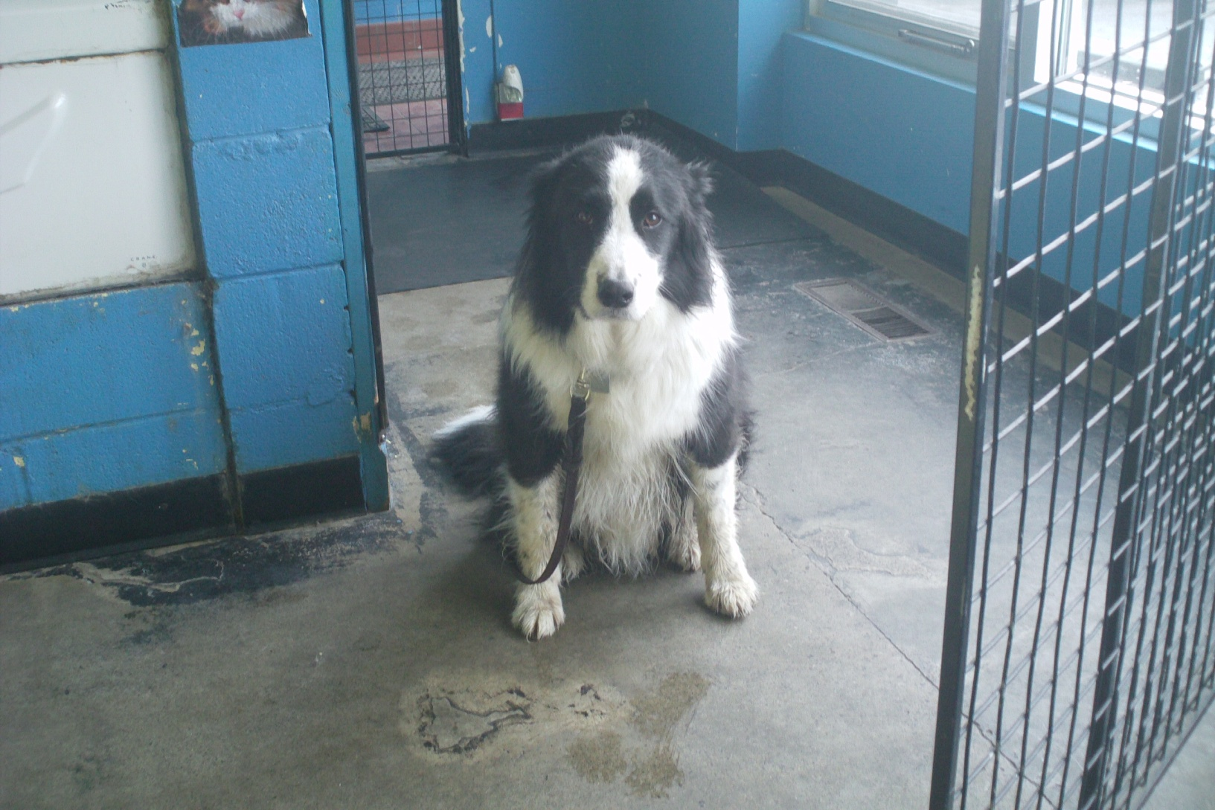
All you need is to be a dirty, a hairy and/or a smelly dog.

Slide 7
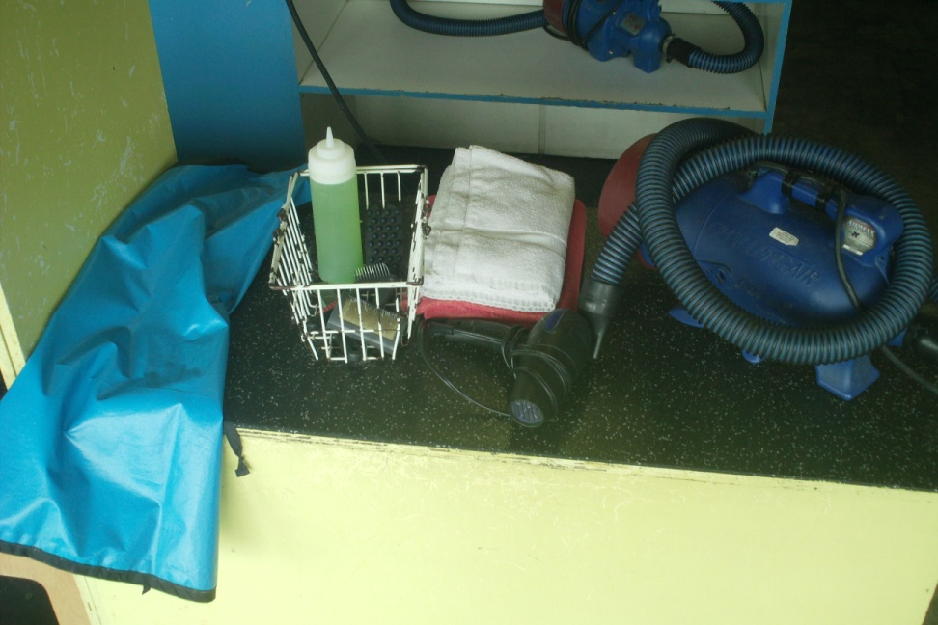
We’ll provide you with everything needed to get cleaned up.
A Tub with Attached Lead
Shampoo
Brushes
Towels
An Apron
A Professional Grooming Blower
Grooming Table with Attached Lead
Nail Clippers/Scissors (upon request)
I have a few tips for you . Please follow them closely and don’t hesitate to ask questions.

Slide 8
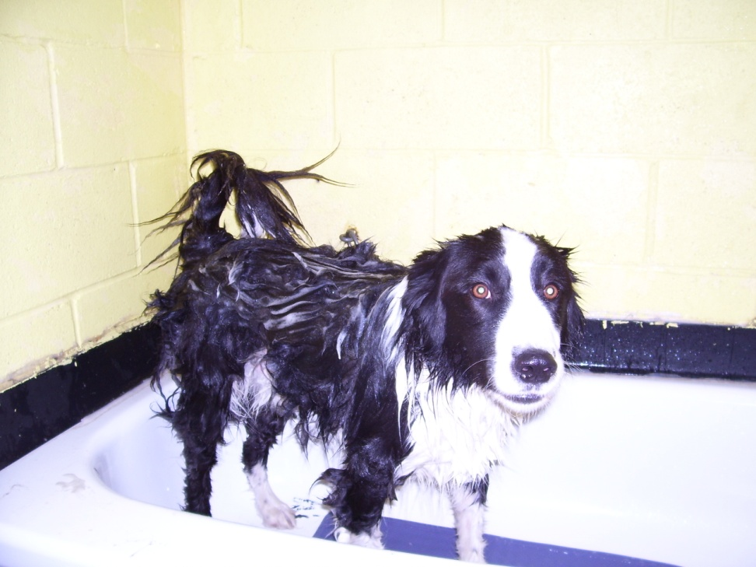
THE BATH
Ensure your dog’s coat is MAT-FREE!!
Wet the dog down completely.
Cover the dog with soap and lather.
Rinse thoroughly...Any left over shampoo residue can cause future itching.
Note: The water pressure and temperature are pre-set.

Slide 9
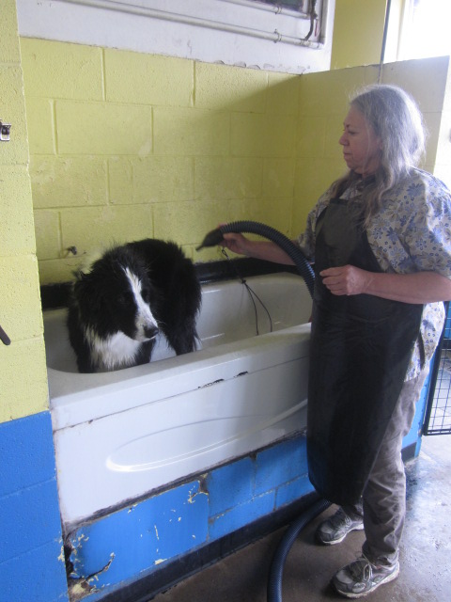
DRYING IN THE TUB
Blower MUST remain on the floor at ALL times!!
Towel dry the dog’s head and ears, causing it to shake.
Use the professional grooming blower provided to remove ALL excess water from your dog’s coat. Make sure your dog stands during this process so that water does not pool under their backside and tail.
Hint: The dryer you get your dog, the more hair you will get out and the less you will take home.

Slide 10
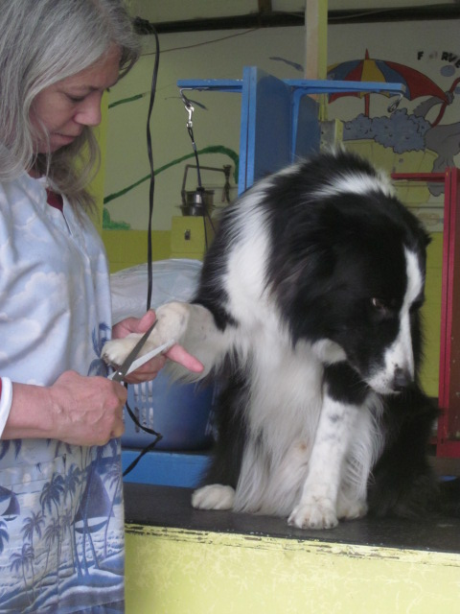
THE GROOMING
Once the dog is no longer dripping, move him/her over to the table to finish blowing out the water and for brushing and trimming.
We would be happy to help you trim your dogs nails for an additional charge.
If you have a breed of dog that can be shaved, please feel free to bring your clippers with you. We do not lend ours but you are welcome to use your own here.

Slide 11
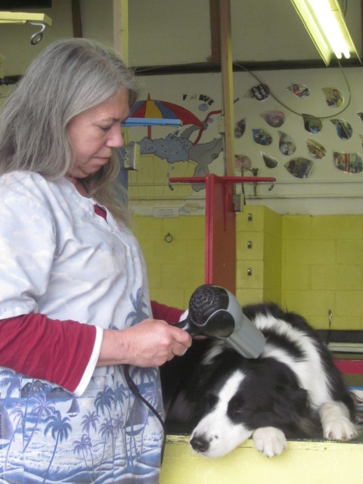
To finish drying your dog’s head, please use the hair dryers provided.

Slide 12
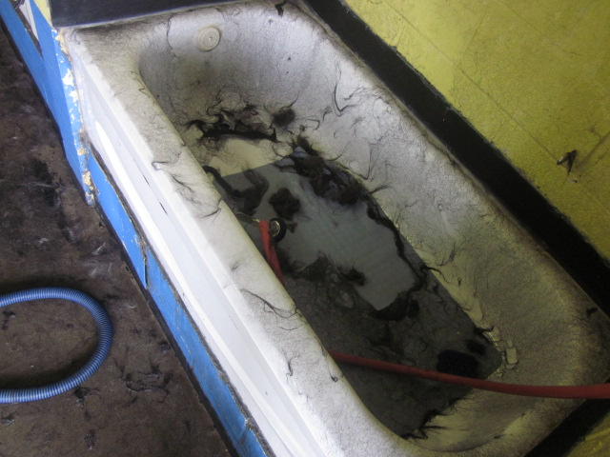
Take all the time you need and leave the mess behind!!!

Slide 13
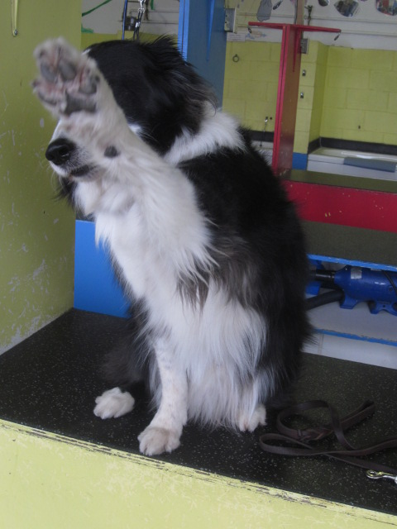
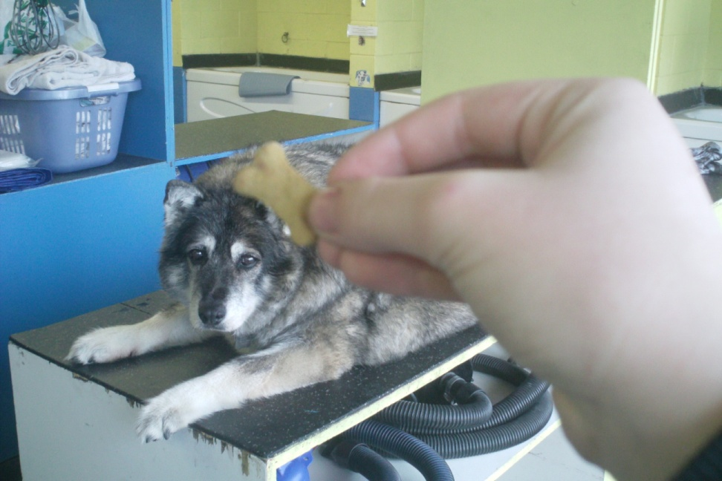
Good Job!
Dogs should be rewarded for a job well done.
Treats for your dog are available at the till .
Good Bye!!!
Come back soon!

Slide 14
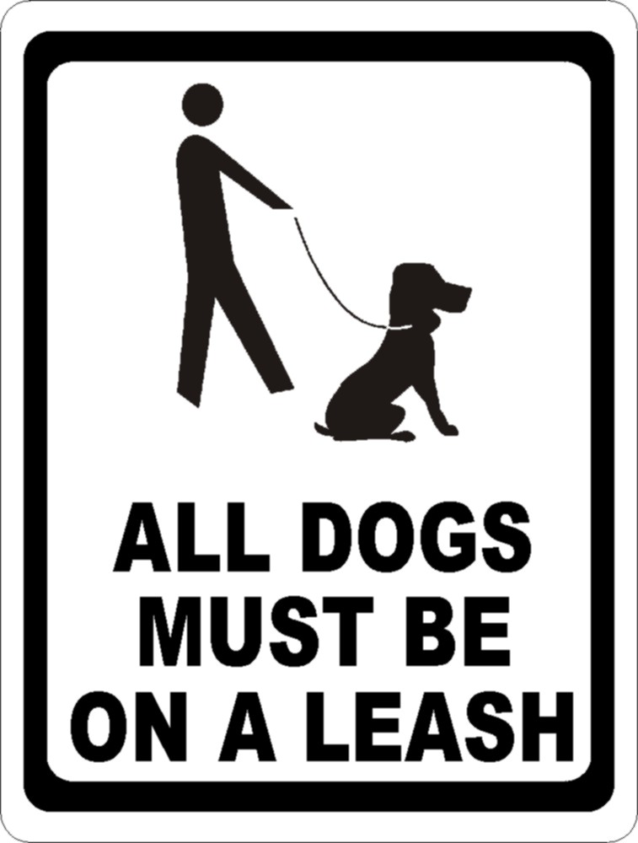
BASIC EXPECTATIONS
Notes for the owner:
All dogs are welcome but must be on leash and under control at all times.
Please ‘potty’ your dog along the fence at the west end of the building, NOT on the grass beside the road or on the building. Remember to scoop your poop.
If your dog has an ‘accident’ in the facility, mops and bags are available.
All dogs must be in the tub at least 45 minutes prior to closing.

Slide 15
OTHER SERVICES
Full Serve Dog Wash
Are you short on time? Ask us about our full serve bathing services
(by appointment only).
Mon to Fri 9am to 3pm.
Dog Classes
We offer Obedience classes Saturday mornings and Agility classes on Thursday evenings.
Doggy Daycare
Does your dog need a place to socialize, exercise and/or play?
We have doggy daycare available Mon to Fri 7am to 7pm. (No need to book).

Slide 16
Launder-A-Pet and
On Track Canine College
455 42nd Avenue S.E.
Calgary, Alberta
403-243-3519
www.launder-a-pet.com
Hours of Operation
Monday to Friday
7am to 7-pm
Saturday
10am to 5pm
Sunday and Holidays
Closed
Self-Serve Bathing Prices
Small (under 20 lbs.) $12.00+gst
Medium (20 to 60 lbs.) $16.00+gst
Large (60 to 100 lbs.) $20.00+gst
X-Large (over 100 lbs.) $24.00+gst
Nail Trimming $6.00+gst
In addition to our great prices, we also have a frequent bather program.

